Slide 1
Before we begin…
Do you have snacks/fluids?
Have you created your personal AWS account?

Slide 2
Cloud Network Security
Using AWS Day 1

Slide 3
Currently responsible for supporting Seek’s Shared Cloud Networking solutions!
Co-Organiser for DevOps Girls
‘Fell’ into Cloud Networking, but LOVE it!
Passionate about diversity, inclusion and non-traditional pathways to technology
Always learning
Hello, I’m Franca
Platform Engineer @ SEEK

Slide 4
Bec our Teaching Assistant

Slide 5

Who are you?
Image sourced from: https://broadlygenderphotos.vice.com/

Slide 6
Day 1 Agenda
Agenda Day 1:
Express AWS Primer
Morning Tea 10:15am-10:30am
Express Networking Primer
Lunch 12pm-12:45pm
Setting up our Cloud Network
Afternoon Tea 2pm-2.15pm
Network Testing
Whiteboarding
Wrap-Up by 4pm
2 days of cloud network security concepts!

Slide 7


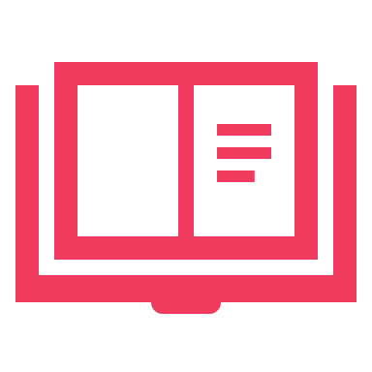
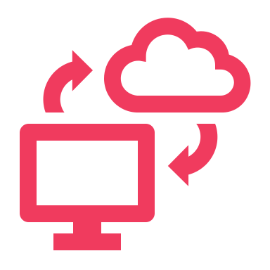


Two Modes of Learning
Theory
We’ll introduce you to some concepts and answer questions
Hands On
We’ll jump into the AWS console and start creating our cloud networks

Slide 8
Code of Conduct
How to ask questions
Getting help if you’re stuck during the practical
Fight virtual fatigue

Slide 9
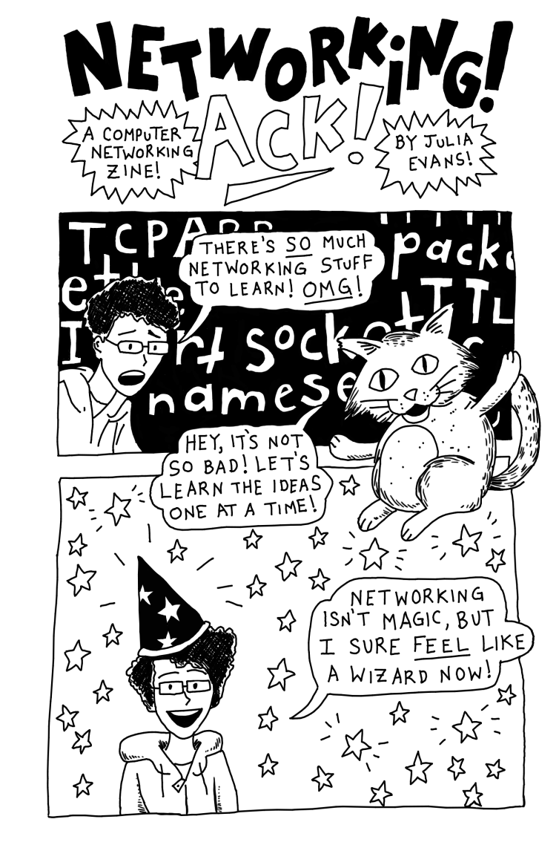
Networking 101
Digital Copy:
Jvns.ca/networking-zine.pdf
Created by Julia Evans
@b0rk
Notes:
Zine talk about Ips, CIDR ranges, SSL, ports, subnets
Also: https://jvns.ca/blog/2018/07/24/ip-addresses-routing/

Slide 10
The what and why of AWS
What is AWS?
Why do we use AWS?
Over 200+ services to enable cloud based infrastructure that you can manage
One of many providers of cloud infra such as MS Azure, Google, IBM, and more
Data storage, compute power, networking, web hosting, etc
Enables scalable infrastructure in a highly secure environment
Reliable, flexible, and available
Unparalleled service offerings (150+ more than Google)
Best in class support, redundancy, and availability

Slide 11
History: What came before AWS?
Then:
Now:
Long lived, dedicated servers
Long lead times for new contracted infra
Estimated infra, often over-provisioned
Fixed hardware, low scalability
Short lived, shared services
Cost shared by consumers
Infra on demand
Virtual hardware, highly scalable

Slide 12
Shared Responsibility Model
Security OF the cloud
Hardware
Physical Access
Software eg. NGINX EC2 image
Security IN the cloud
Application Security
Configuration of AWS Resources eg. s3
IAM
Cloud Network Security
Notes:
AWS Data Centers:
https://aws.amazon.com/compliance/data-center/data-centers/

Slide 13
Networking OSI Model (Open Systems Interconnection)
7 Application Layer
For human consumption – what we see eg. HTTP, SNMP, FTP
6 Presentation Layer
Processes data to be used by the app layer, including encryption/decryption, jpg, SSL, TLS
5 Session Layer
4 Transportation Layer (TCP/UDP)
Responsible for transporting packets in a way that covers flow control and reliability
3 Network Layer
Routing data from A to B going across boundaries – IP’s, ICMP, IPsec, IGMP
2 Data Link Layer
How data is linked up from point A to B eg. ARP, MAC Address
1 Physical Layer
Hardware responsible for data transmission – eg the physical cables, hubs, wireless
Creation/Tear down of network connections
There is still
a lot to
configure
securely
AWS’s
Responsibility

Slide 14
Cloud Networks - AWS
22 Regions - Australia’s Region is ap-southeast-2
69 AZ’s (availability zones) There are 3 in Sydney, Australia
Every time you create a VPC, you’re using part of this network
Group Activity Time!

Slide 15
Intro to AWS Networking Resources
Defines where network traffic can go from your subnets or gateways
Isolated part of the cloud of your AWS services
Packet filter associated with a subnet
Connects your VPC to the internet
A managed AWS service that distributes traffic to targets you specify
Translates a private IP to a public IP for secure internet access for private AWS resources
A subset of your VPC
Securely connect your VPC to on-prem infrastructure/private networks
Set of rules to block/allow inbound/outbound network traffic
Determines number of IPs your VPC can have
Allow you to connect to an EC2 using an IAM role, without AWS credentials
Virtual Private Cloud (VPC)
CIDR Range
Subnets
Internet Gateway (IGW)
NAT Gateway
Direct Connect/VPN
NACL
Route Table
Security Groups
Load Balancer
Systems Manager Agent (SSM Agent)

Slide 16
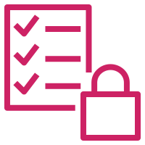


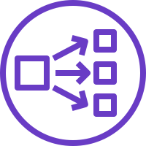
What does this look like as infra?
VPC + Subnets
Internet Gateway
Private + Public Route Table
NAT Instance
Security Group
Public Load Balancer
Private Servers
VPC
Security Group
Private Subnet
Public Subnet
Web
Servers
HTTPS
Load Balancer
Internet
Public Route Table
NATG
Private Route Table
EIP/ Public IP

Slide 17
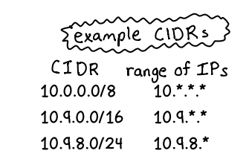
IPs and CIDR Ranges
IPs
It’s an identifying address for a routable resource.
IP addresses contain 4 octets, each consisting of 8 bits giving values between 0 and 255
CIDR (Classless Inter-Domain Routing)
A CIDR is a group of IP’s allocated to a part of your network.
Taken from Julia Evan’s zine.
As the netmask gets bigger,
you get less IPs

Slide 18
Key Terms…
Netmask
/x tells you how many IP’s are available in your CIDR – the smaller the number, the more IPs you have. Eg. /24 indicates there are 265 IP’s available
Network ID
This is part of your IP that is shared for all resources within your network. Eg. 193.164.2.44 and 193.164.2.35 are part of the same network
Host ID
This is part of your IP that is unique to one resource. Eg. 193.164.2.44 and 193.164.2.35 are IP’s for different resources

Slide 19

Subnetting
Once you know how many IP’s are available in your network, you can split this into subnets.
We will not be covering subnetting today
Play around with subnetting though:
https://cidr.xyz

Slide 20
How does this apply to our network?
10.0.0.0/16
VPC
Security Group
Private Subnet
Public Subnet
Web
Servers
HTTPS
EIP/ Public IP
Load Balancer
Internet
Public Route Table
NATG
Private Route Table
EIP/ Public IP
Known to the internet
Eg. 193.164.2.44
and 193.164.2.35
10.0.1.0/24
10.0.2.0/24

Slide 21
Let’s get into the console!
We’re going to use step-by-step guides in GitHub to build….
VPC
Public Subnet
Private Subnet

